Slide 1
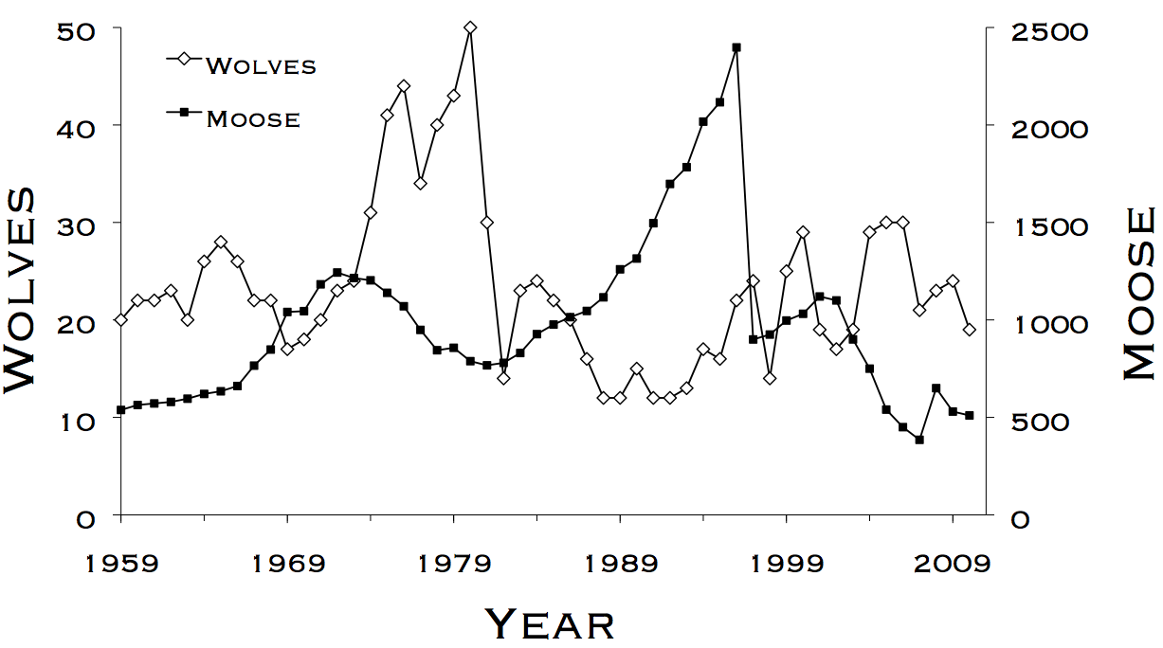
Lab 2 – Exponential and Logistic Growth
WLE 411, Week 4

Slide 2
Readings and deadlines
Lab 1 assignment due at the start of class
Readings for this lab:
Chapter 2- Context and Inference
Notes:
Philosophy of statistics and parameter estimation

Slide 3
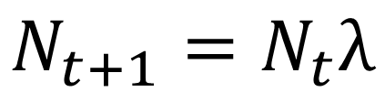
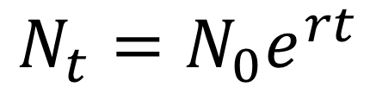
Exponential growth
Continuous
Discrete
$$N_{t}=N_{0}e^{rt}$$
or
$$N_{t+1}=N_{t}λ$$
In what circumstances do we expect exponential growth to occur?
Abundant resources
Examples:
Bacteria in a petri dish
Invasive species (ex. rabbits in Australia)

Slide 4
What does exponential growth look like?
Notes:
Unrealistic over large time scales

Slide 5
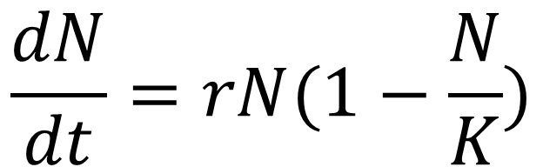
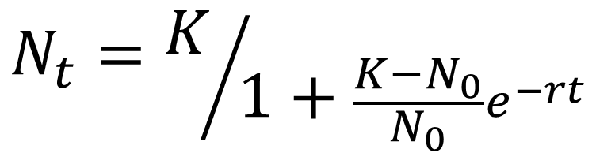
Logistic growth
$$\frac{dN}{dt}=rN(1−\frac{N}{K})$$
$$N_{t}=K/{1+\frac{K−N_{0}}{N_{0}}e^{−rt}}$$
In what circumstances do we expect logistic growth to occur?
Limited resources
Examples:
Large herbivores
Marine predators (e.g. harbor seals)

Slide 6
What does logistic growth look like?
K/2
K
K
K/2
Notes:
What does dN/dt represent?
At what point in this graph is the population growing fastest?
In harvest management, K/2 is an important #

Slide 7
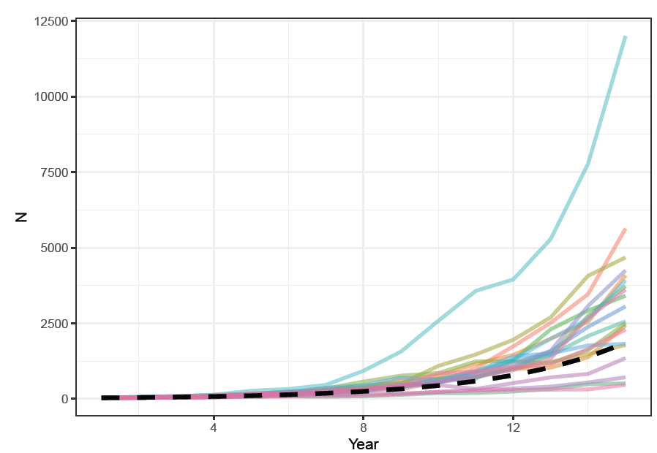
Stochasticity

Slide 8
Strategy for this lab
We have 2 weeks to do the lab
Pace yourself- try and get sections 1 and 2 done today, and 3 done next week

Slide 9
